Slide 1
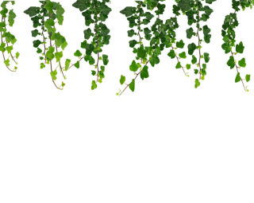

A Way Home
COMP1869

Slide 2
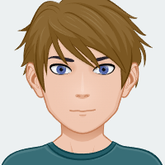

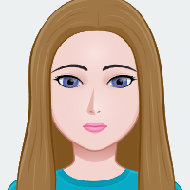

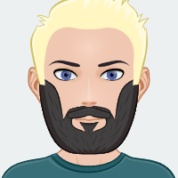
The Team!
Project Lead, Modelling
Rhys
Modelling, Animations, Textures
Rio
Modelling, Textures
Dana
Design, Programming
Elijah
Design, Programming
Zach

Slide 3
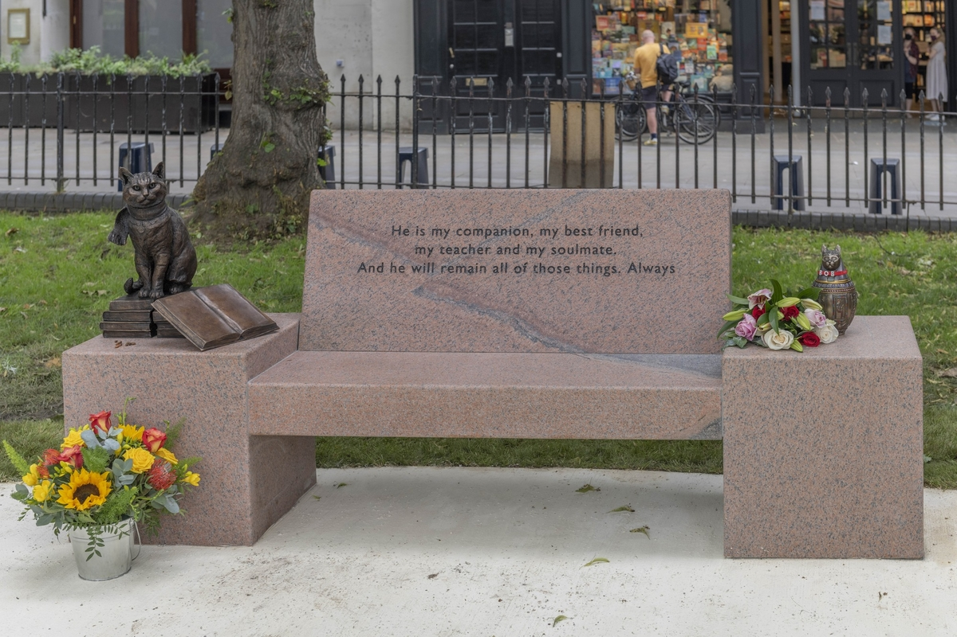
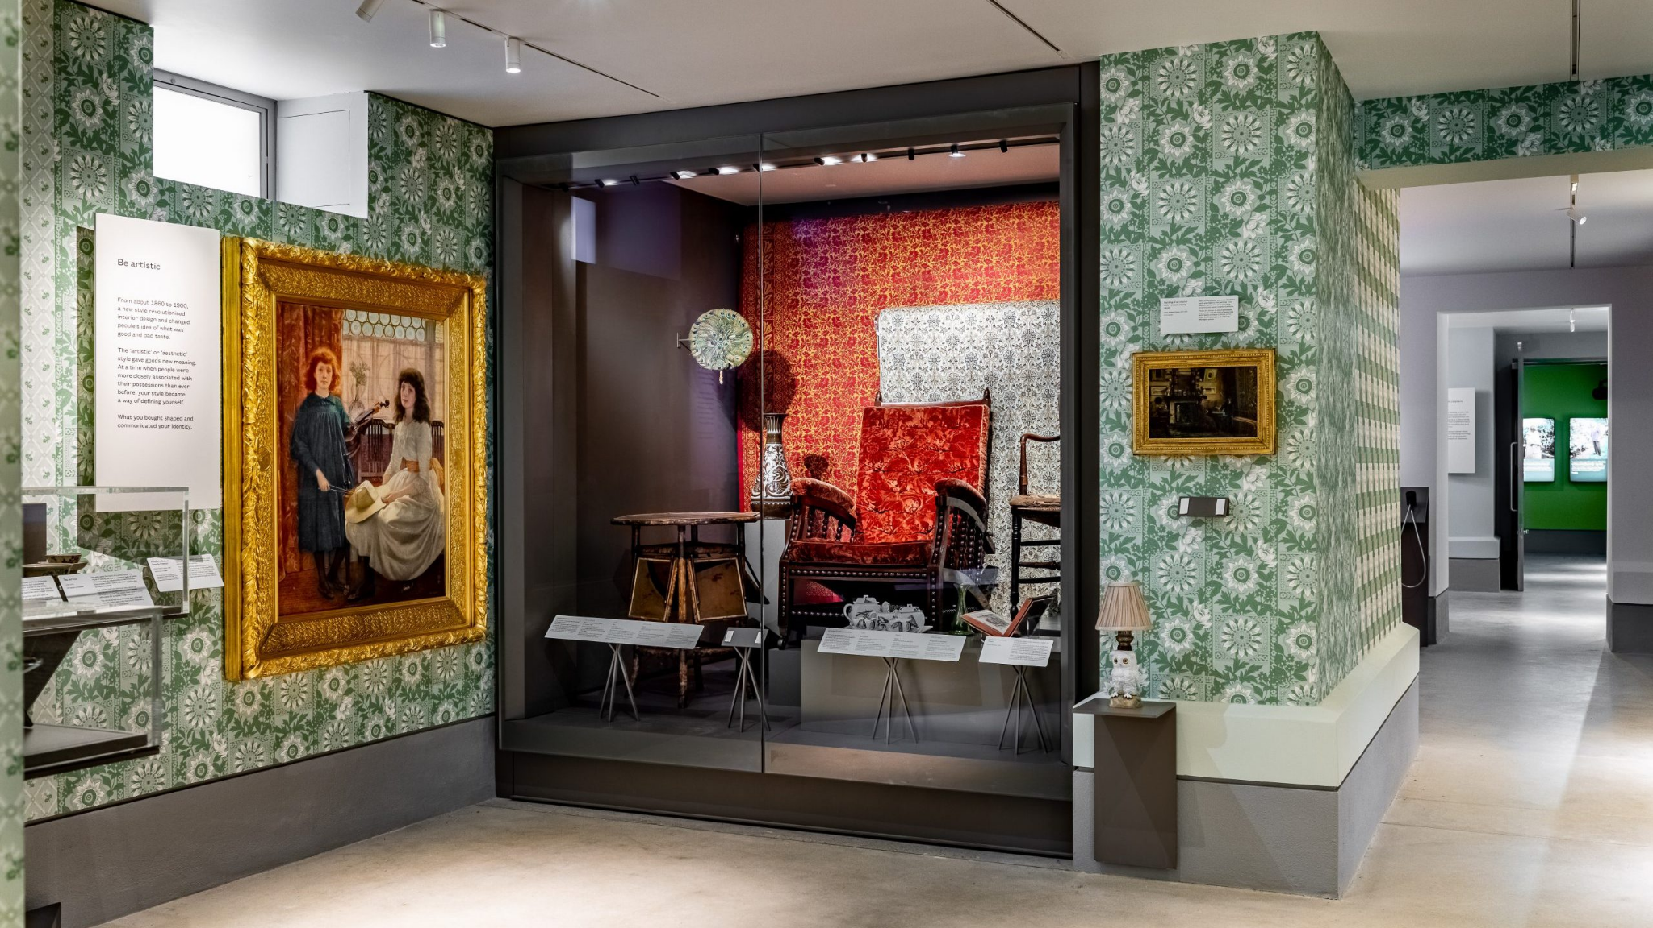
Brief Overview 1
Typeone has required us to make 3 3D, low-poly models for their game engine “PlayCanvas” These were a Parakeet, a Fox and a Cat. They also asked for rigging and animations for their movement.
The models are for use in the “Museum of the Home”, a Museum in London about nature and cohabitation between nature and the urbanised environment of London and society in general. They want them as part of an exhibit that uses AR (Augmented Reality) technology that they plan to implement themselves using the models on behalf of the Museum.
The models are to be made in Blender so they are compatible with the PlayCanvas engine

Slide 4
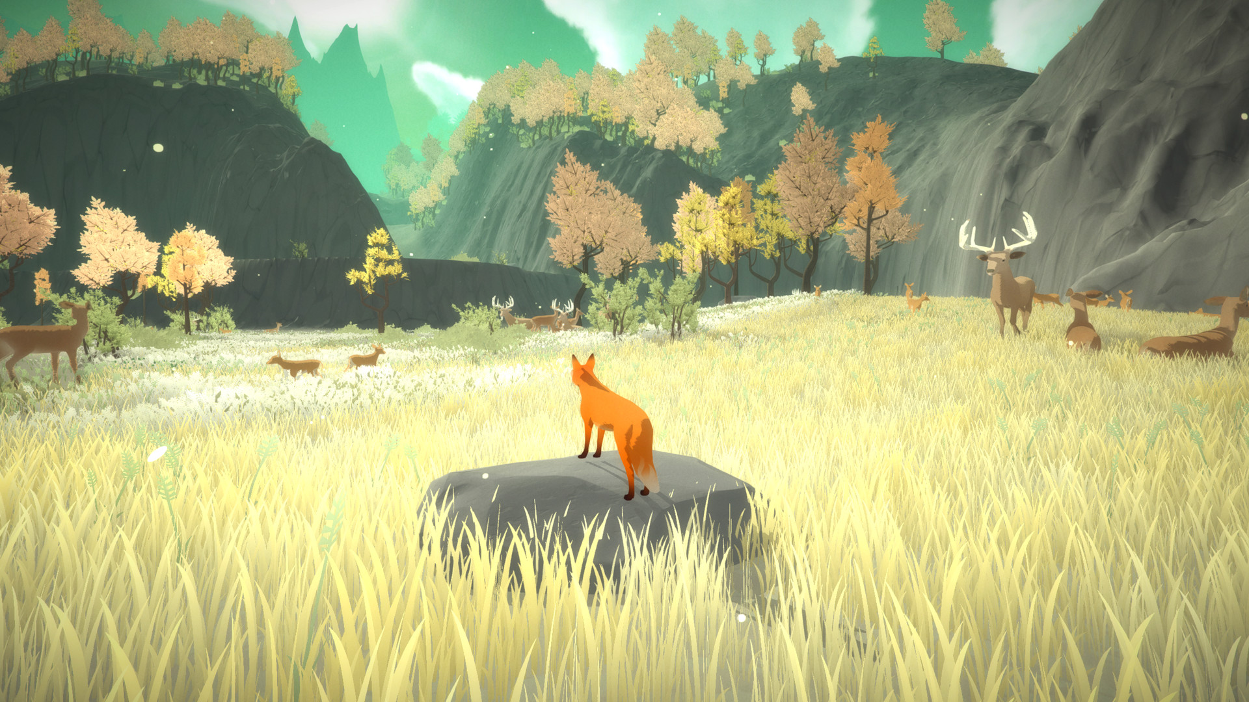
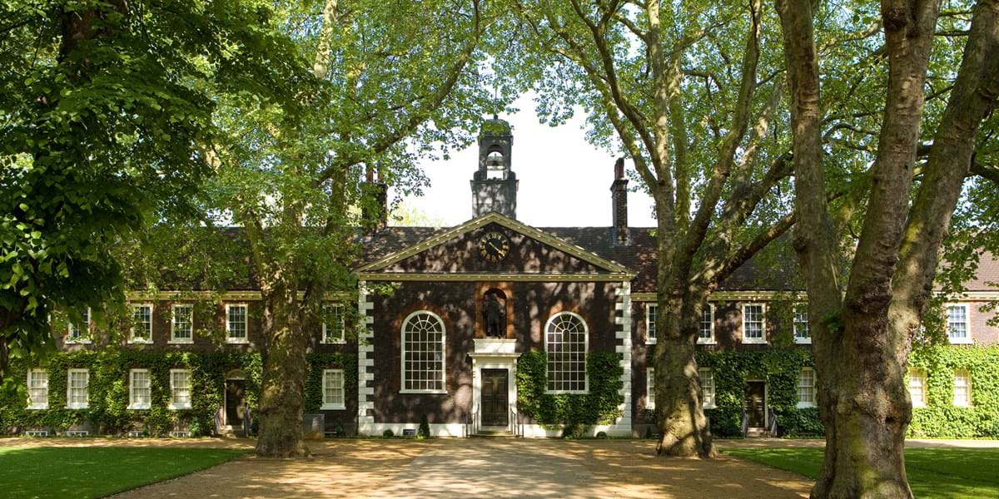
Brief Overview 2
To expand our brief, we decided we would have these animals exploring up to three different environments around London
The game is to be made in Unity, for mobile
The target audience is Museum visitors, so the controls will be very simple to make it as accessible as possible to members of the public, who may not have experience with video games, may have disabilities etc.
We will also include a model of the Museum of the Home’s exterior to feature in the game as a homage to our client

Slide 5
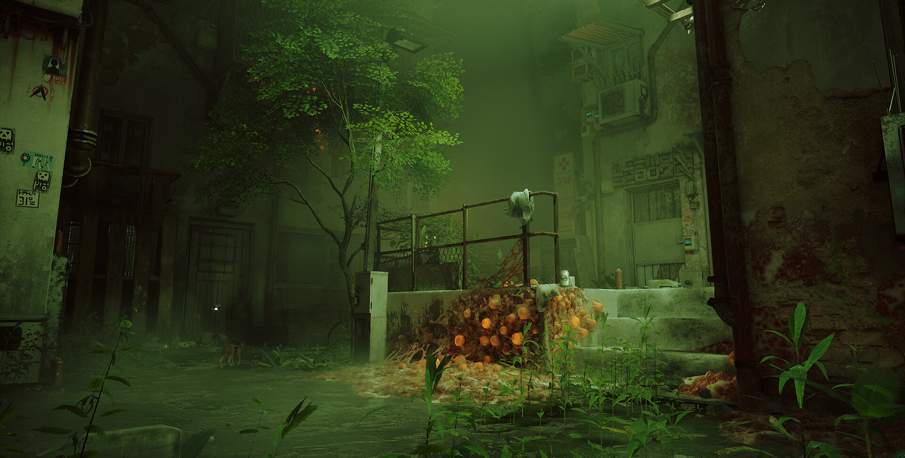
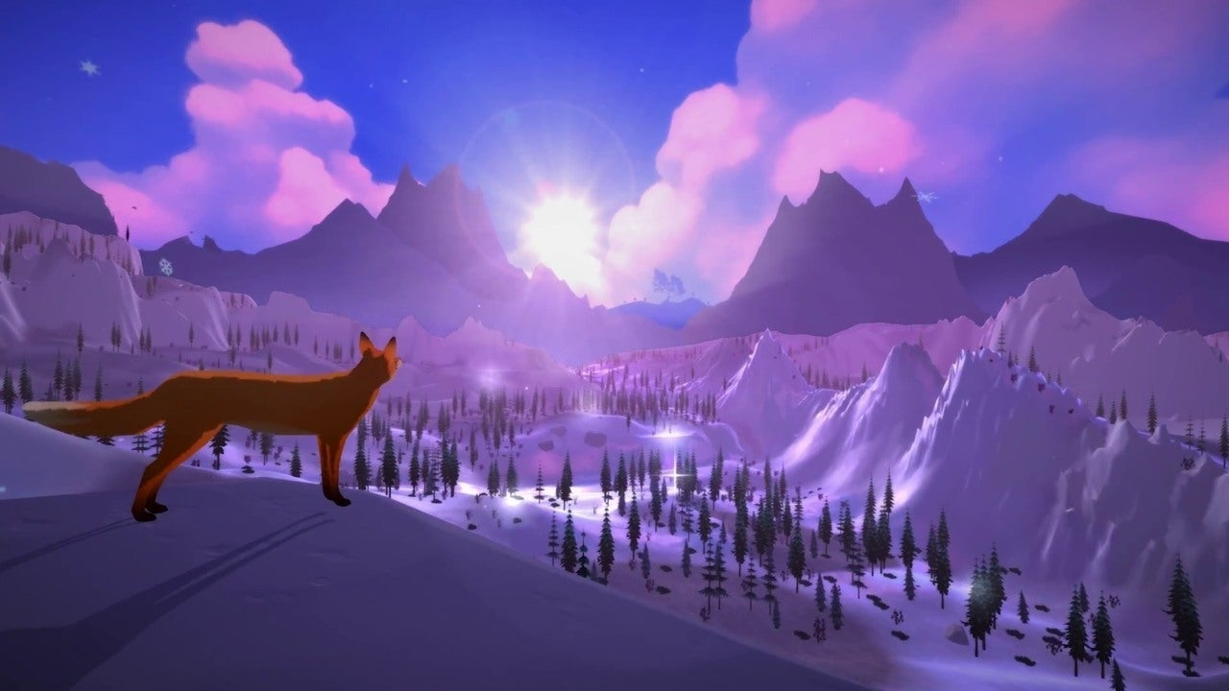
Our High Concept
A Way Home is an exploration focused game like Stray and “The First Tree”. The player will play as either a cat, a parakeet or a fox as they make their way through the environment. They have been displaced from their homes and now need to get back to their families.
There is little sense of urgency or difficulty. Instead, the focus is more on the immersive environment and educational aspects of the game, which suit the Museum target audience. We’re confident our game would be very engaging to the Museum-goers!

Slide 6
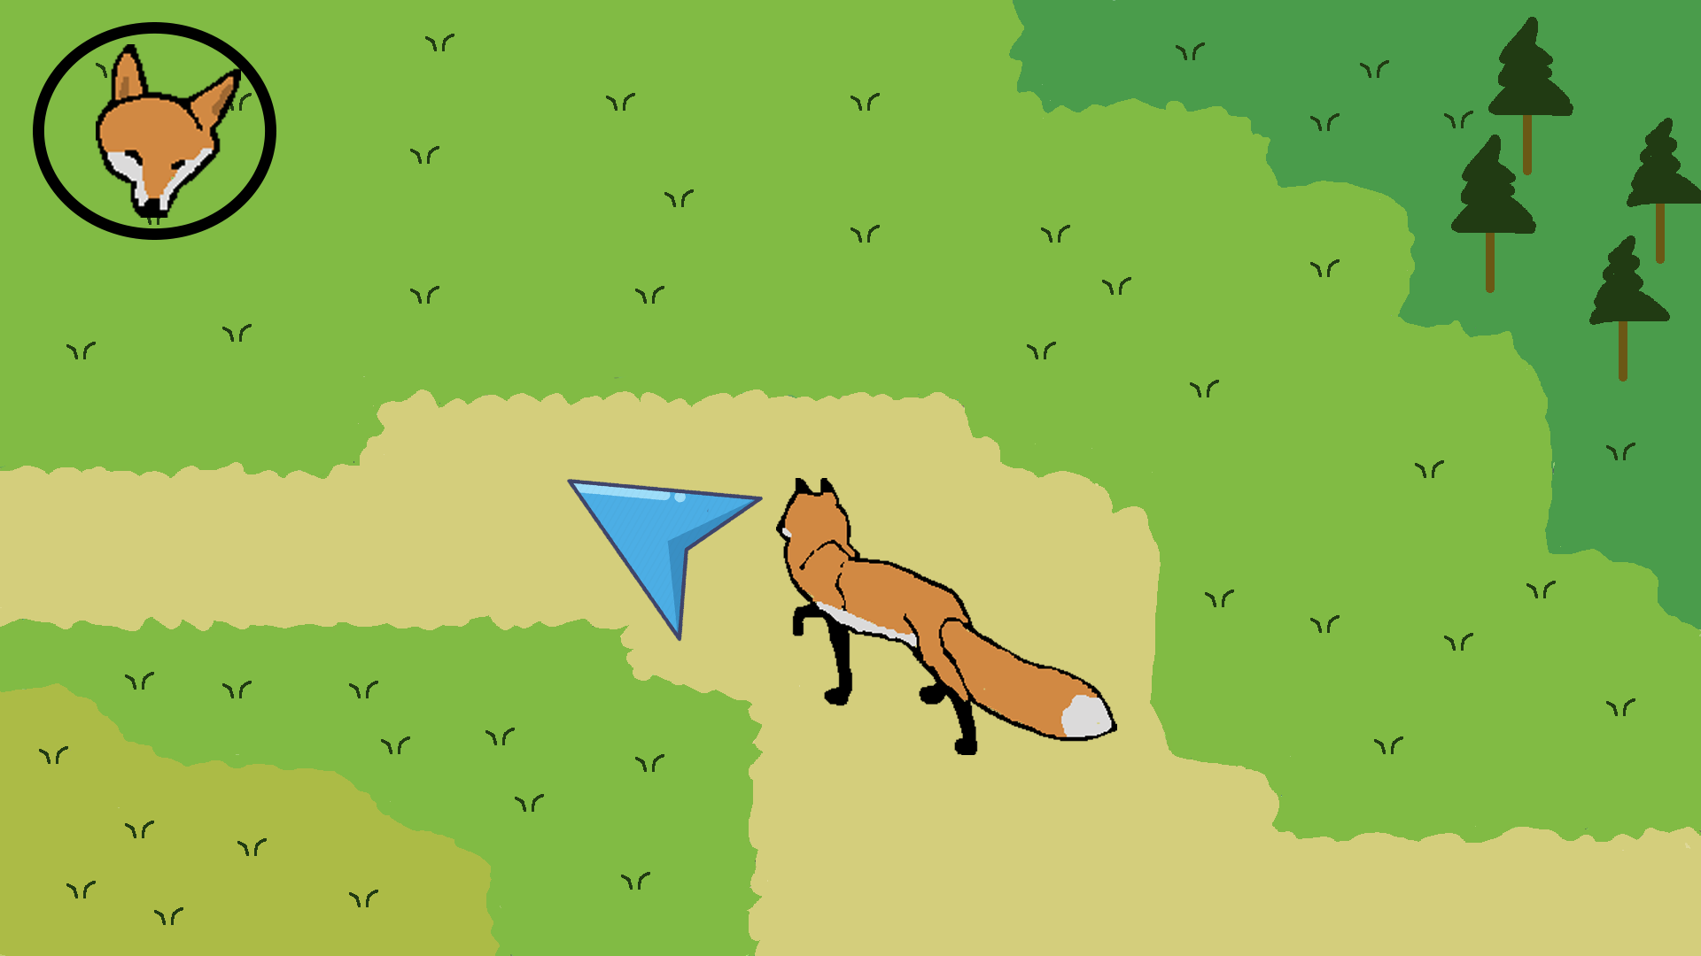
Gameplay
The character is directed with simple point/click and touchscreen controls to keep things accessible and to work well on mobile
Each animal will have a unique ability that will let them pass through specific obstacles to set them apart.
The players will get full freedom in the levels, letting them explore for as long and for as much as they want.
Dialogue boxes would also appear that provide accurate information on the flora and fauna present to increase the educational aspect of the game

Slide 7
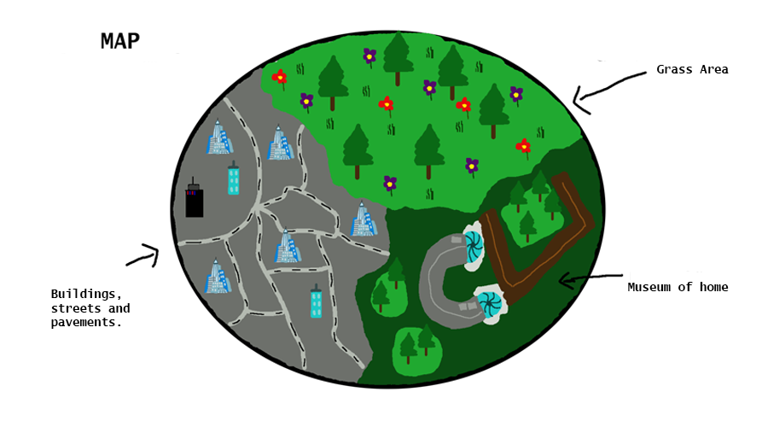
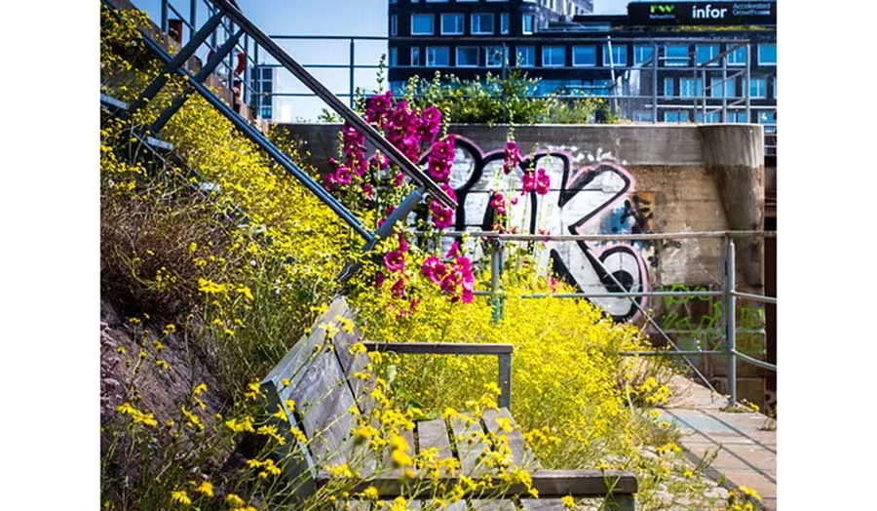
Look and Feel
In accordance to the brief, the game will be low poly. The levels will be a mix of environments around London, combining the natural and urban aspects seamlessly. The feel will be peaceful and calming, to allow users to play at their own pace and take in the experience as best as possible, as well as giving them time to read the educational dialogue presented. Besides the text popups and simple directions, there won’t be much UI, to avoid overwhelming the user and overcomplicating the experience, as well as to help keep it more immersive.

Slide 8
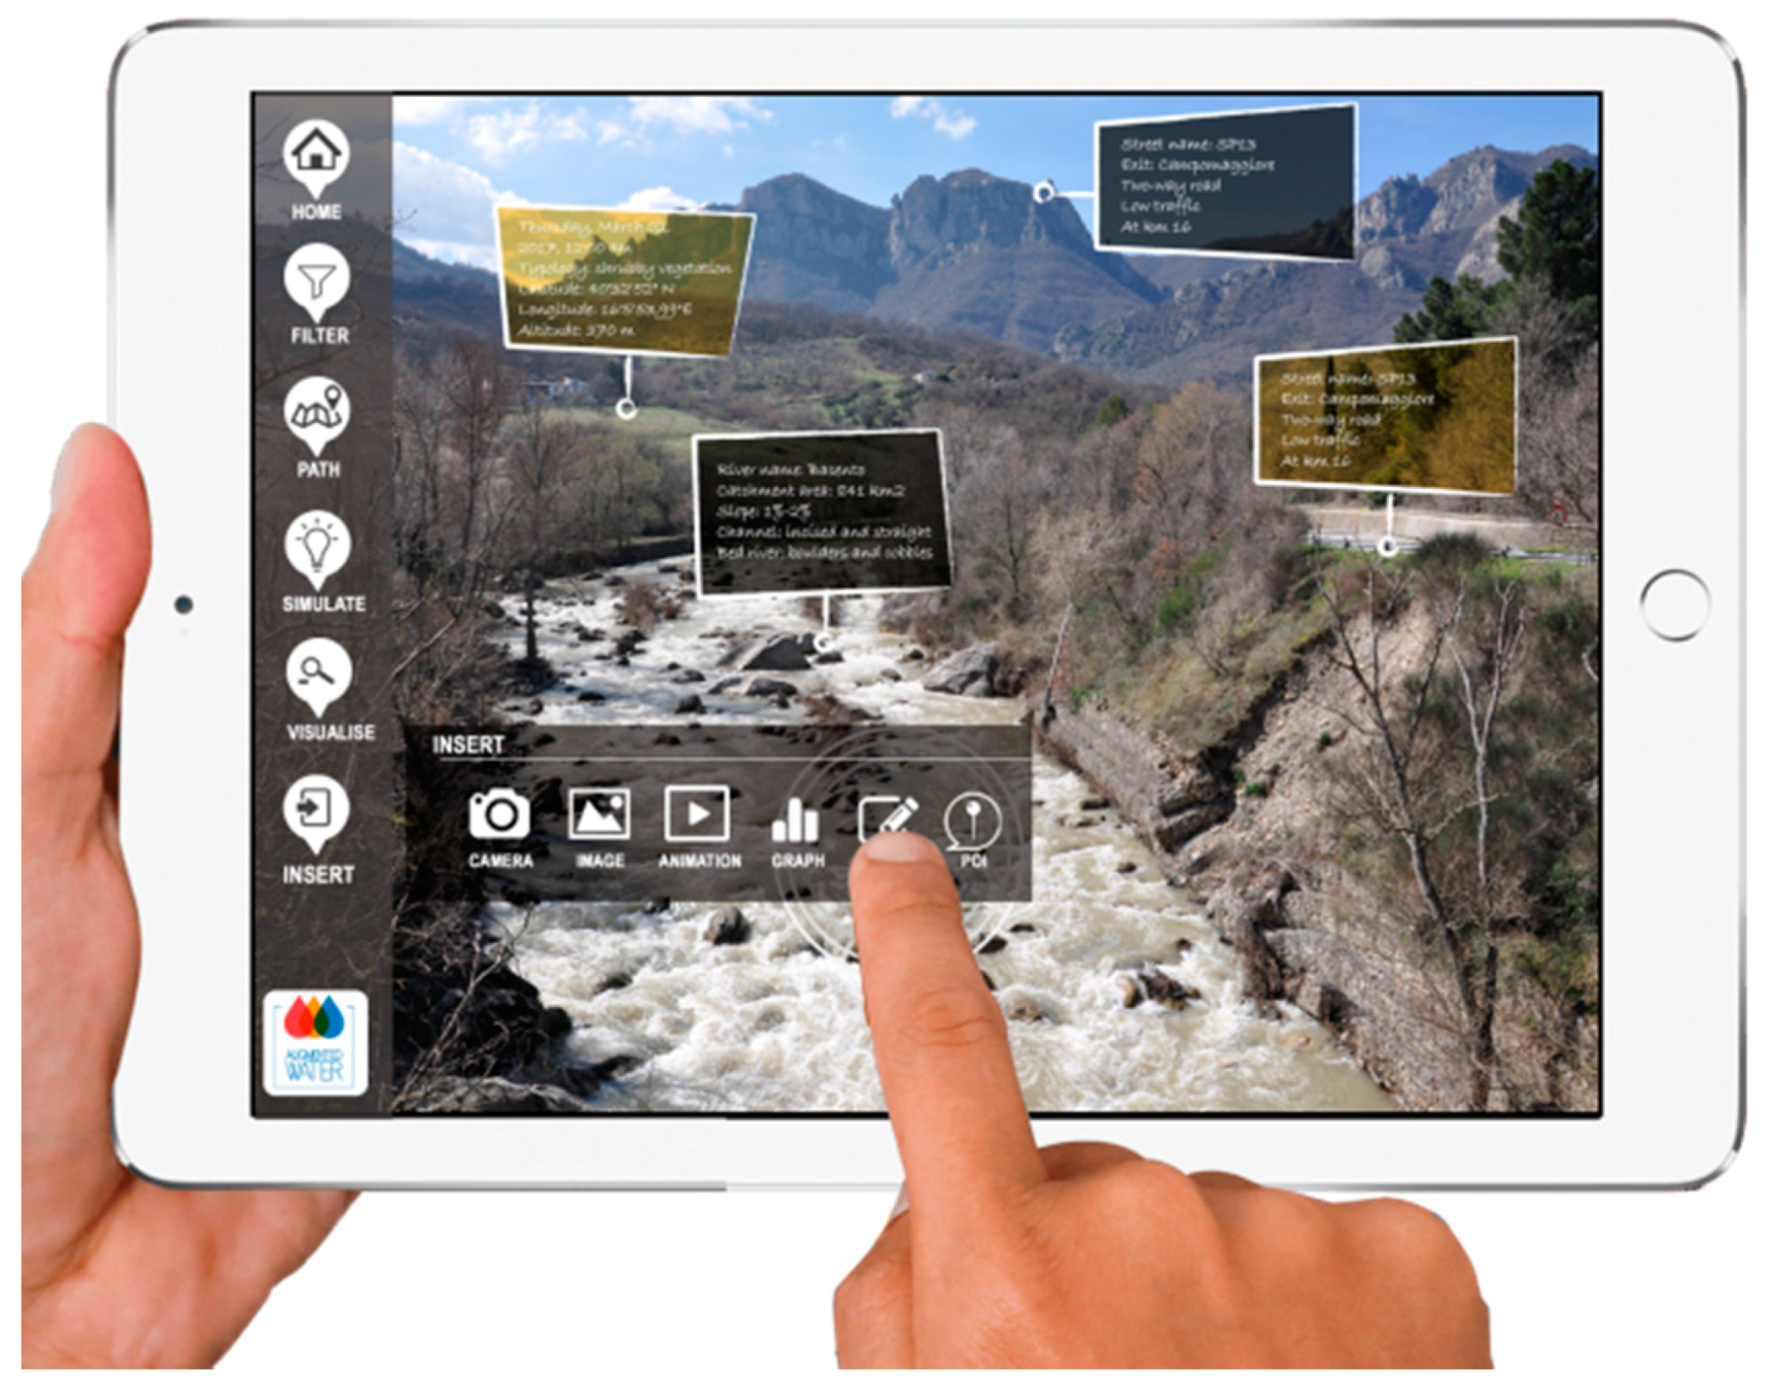
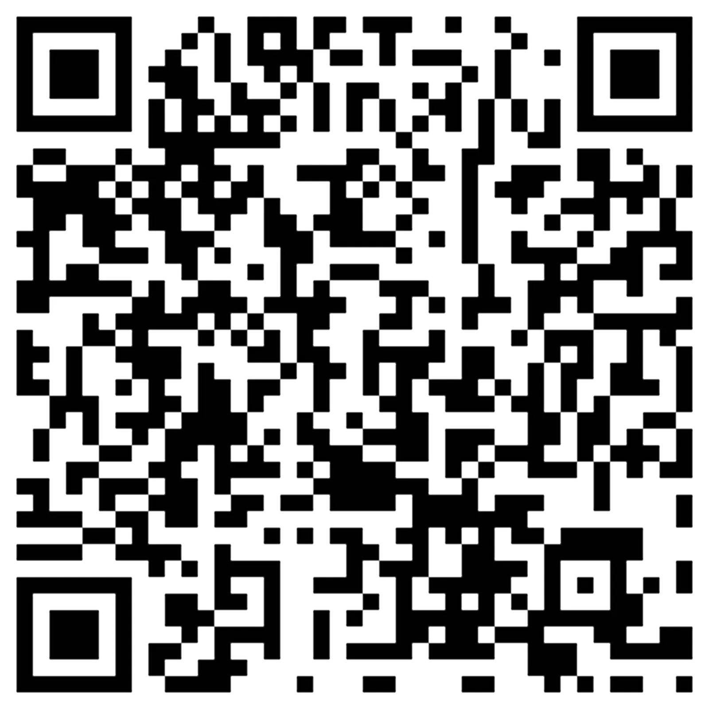
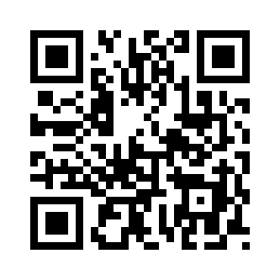
A nod to AR
Since Typeone planned to implement the models into the Museum of the Home as an AR experience, we will reference this ourselves by having QR codes you can scan both in the real world and in game. The real world QR codes would allow you to enter the game on mobile at certain spawn positions with a specific animal. These could then be placed in real life at different locations to help promote the game. Meanwhile, the in-game QR codes would provide a link to relevant media and information around the flora and fauna in the surrounding area. This would be provided alongside the educational popups in game.

Slide 9
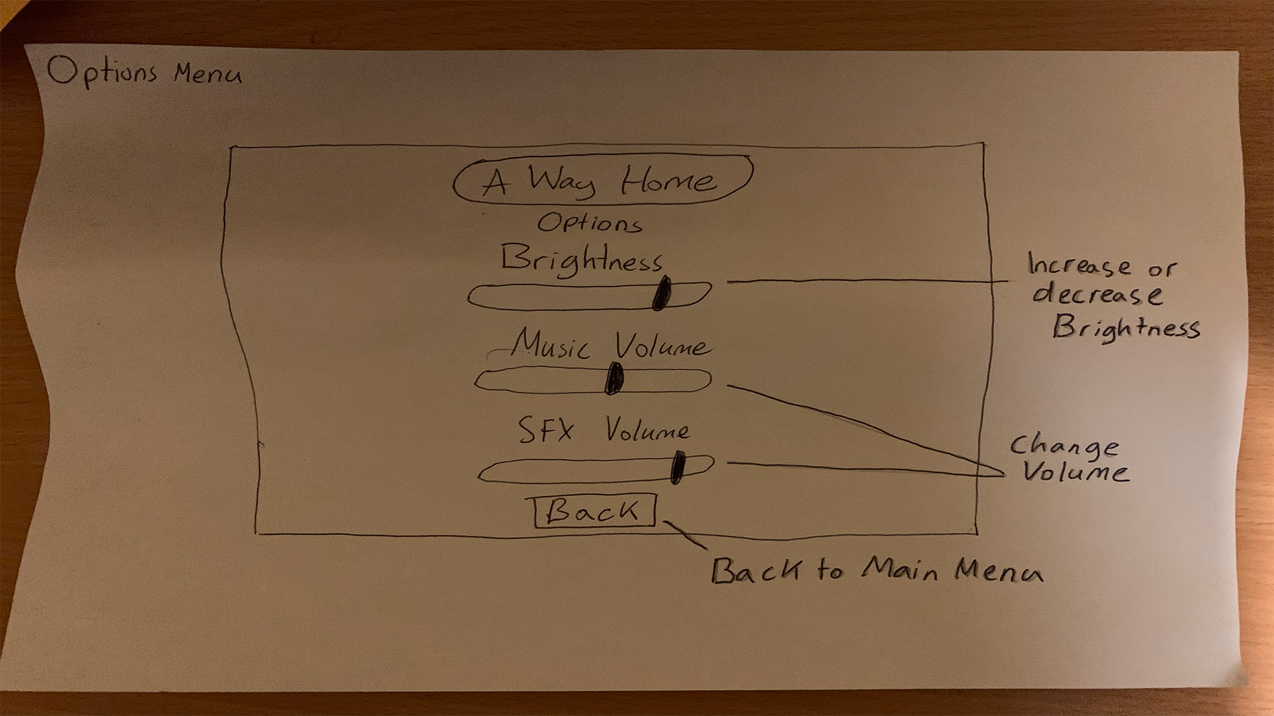
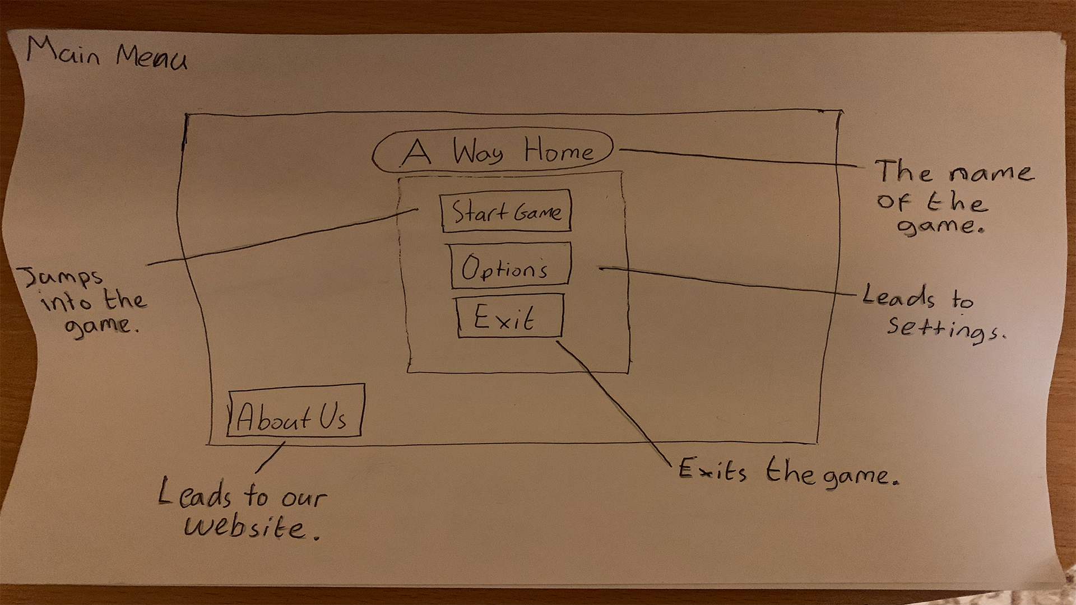
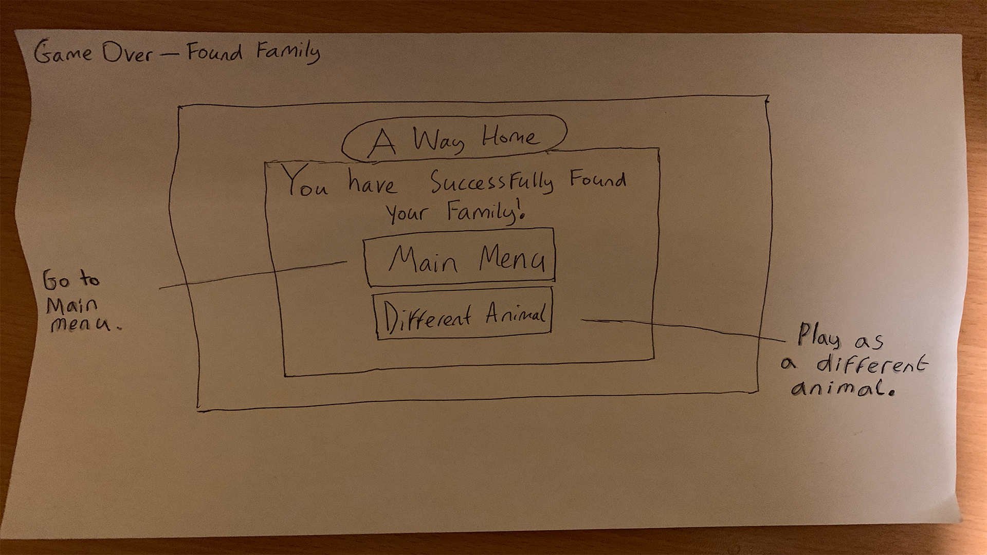
Low Fidelity Prototypes: UI Planning

Slide 10
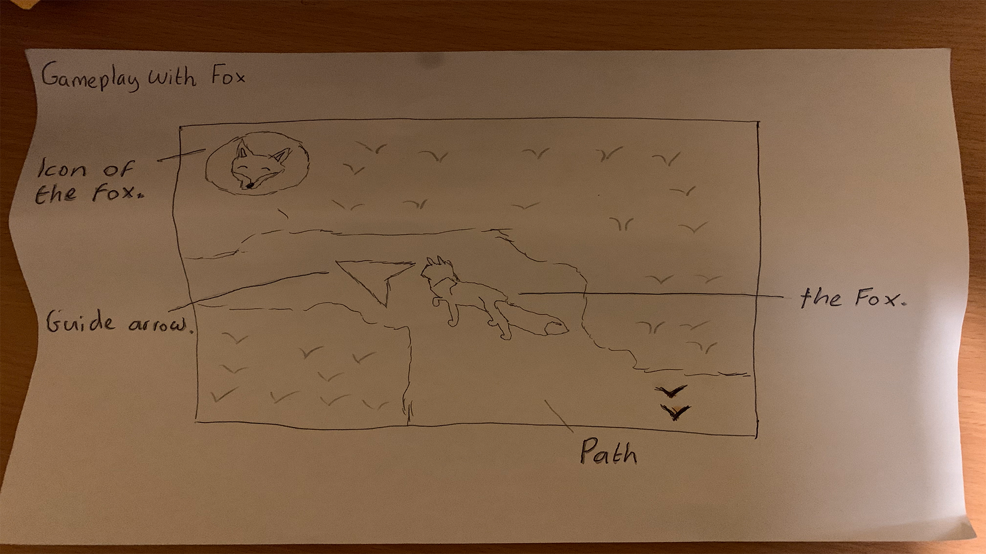
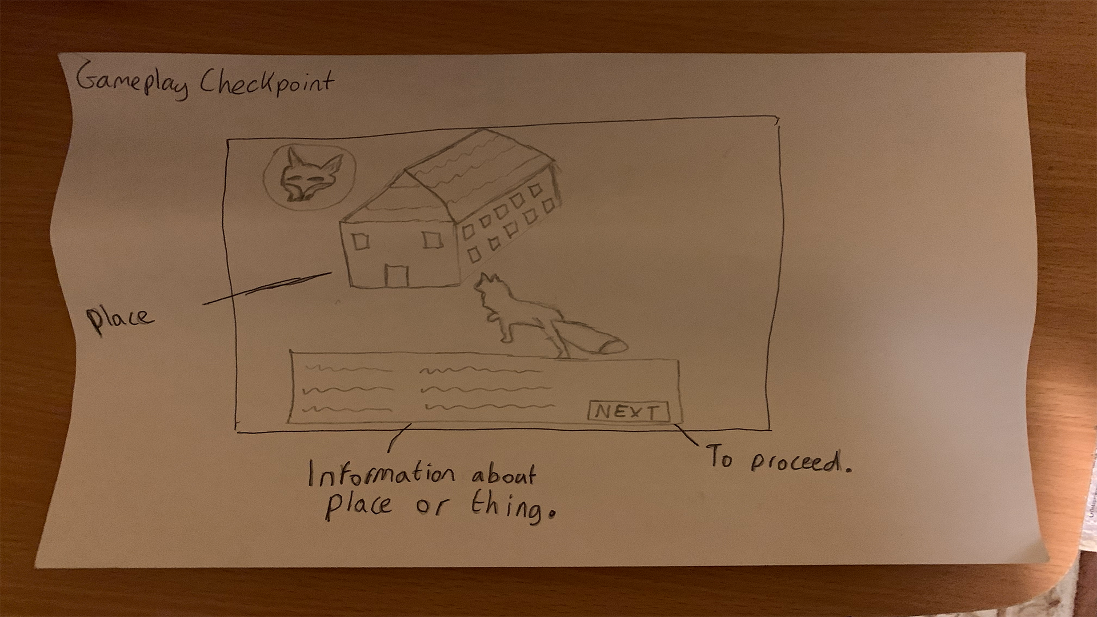
Low Fidelity Prototypes: Gameplay Planning

Slide 11
Low Fidelity Prototypes: Gameplay Planning

Slide 12
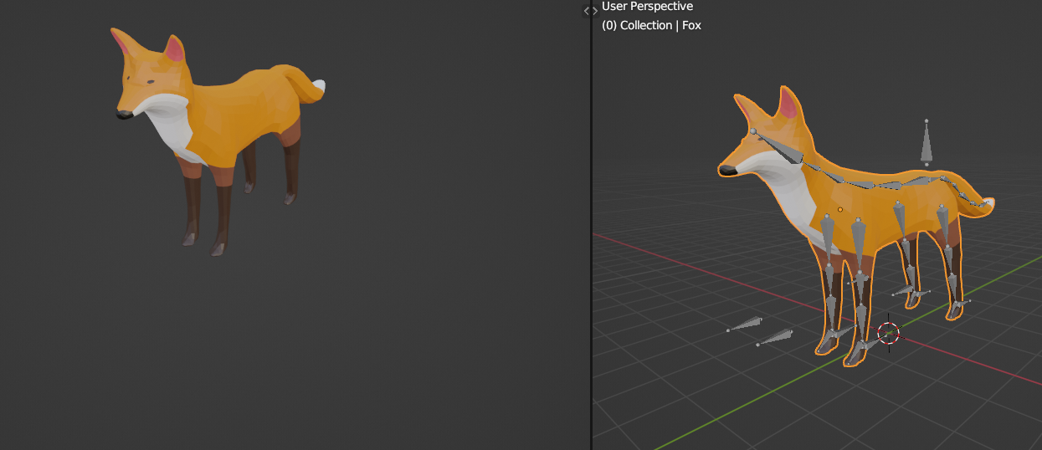
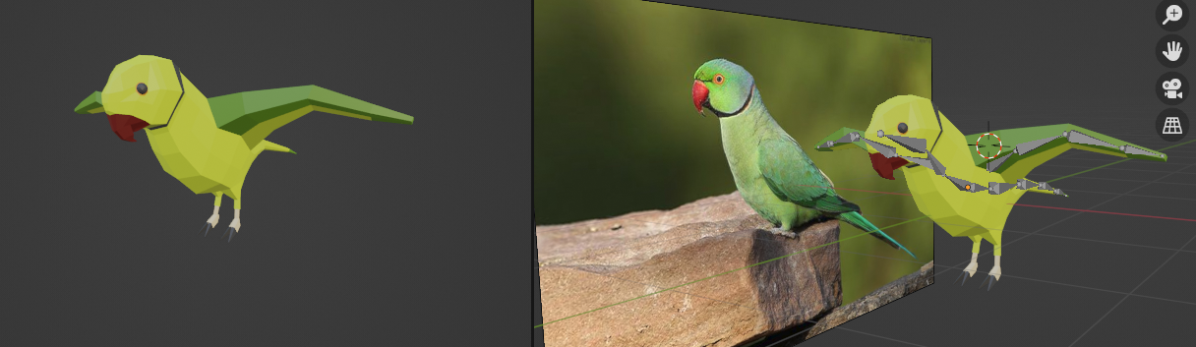
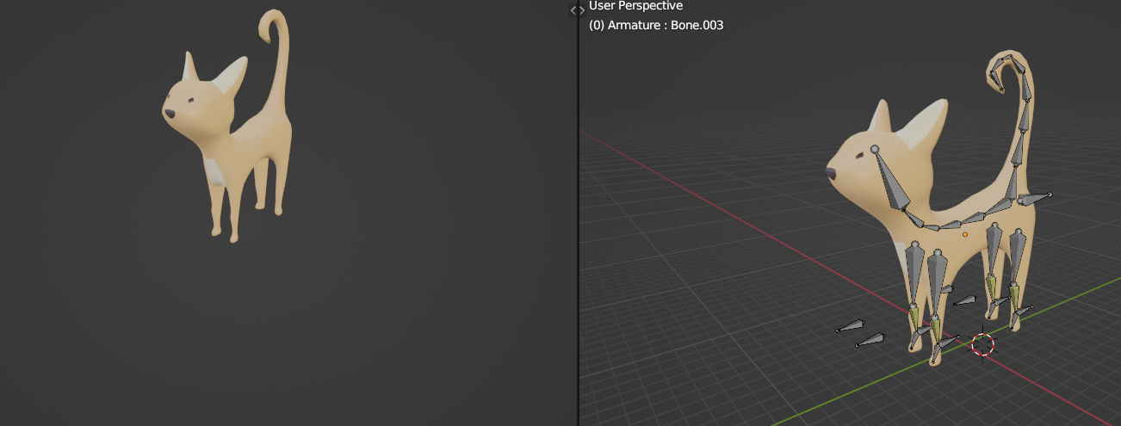
High Fidelity Prototypes: Animals

Slide 13
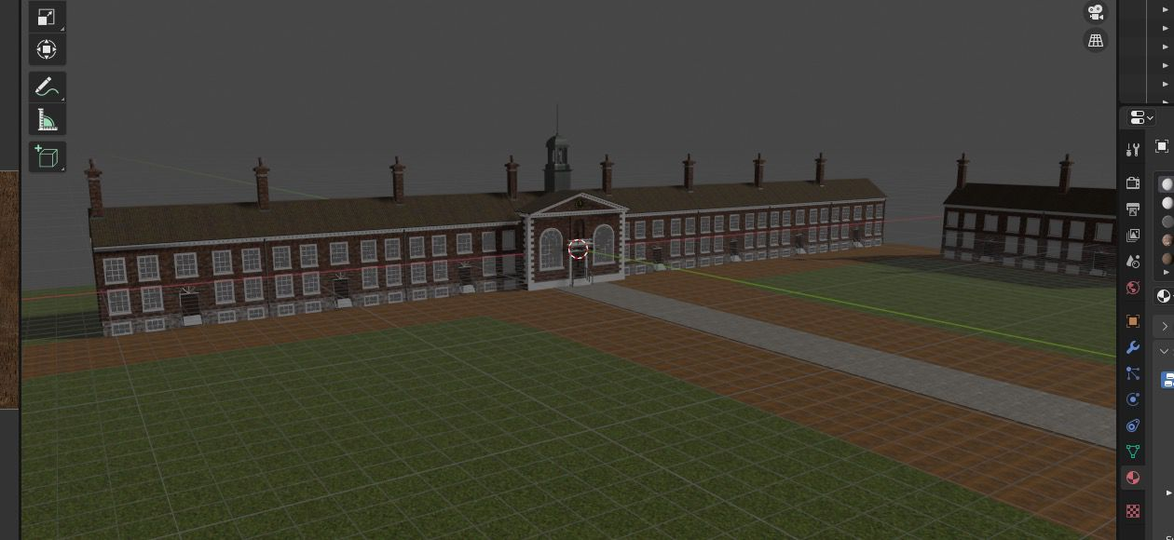
High Fidelity Prototypes: Museum of the Home

Slide 14
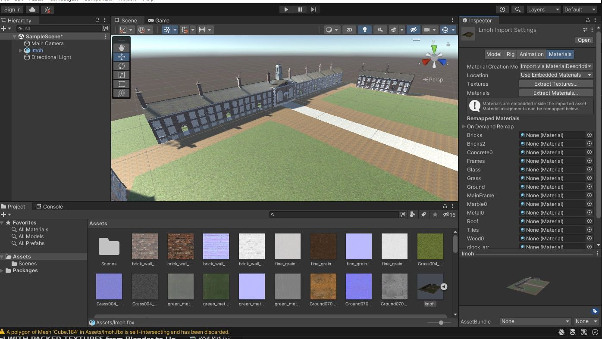
High Fidelity Prototypes: Museum of the Home

Slide 15

High Fidelity Prototypes: Museum of the Home
(References)

Slide 16
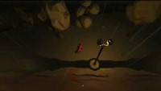
High Fidelity Prototypes: Unity Prototype

Slide 17
Our Project Plan Going Forward
Must Have -A level (sandbox) for all 3 characters to play in -All 3 animals playable, with animations and sound effects -Simplistic, accessible controls -Mobile Support -Simple UI to convey what to do -Educational descriptions of the environment -A friendly, inviting presentation. Shouldn’t be scary! -Low-Poly art style -Models have compatibility with the PlayCanvas Engine -A Museum of the Home model the player can visit (Exterior) Should Have -Individual Levels -Cutscenes/Transitions when swapping characters -Atmospheric lighting, sounds, other beauty-related effects -QR Codes in-game linking to educational resources -“Real”QR Codes you can scan to open up the game on your phone
Could Have -More fleshed out individual levels -Colour-blind accessibility -More complex cosmetic mechanics, such as birds flocking more realistically, weather effects, realistic pedestrian crowds moving around etc. to enhance the experience without actually complicating it for the user Won’t Have
-Multiplayer -A narrator -Complex mechanics -Lots of UI -The interior of the Museum modelled out/accessible -An actual AR game. It is a mobile game, with models built for usage by the CLIENT in an AR environment, and slight AR references with the QR codes, but no more AR than that. -More playable characters besides the initial 3

